Slide 1
Packaging and Deploying SharePoint Framework Solutions
Notes:
This module examines the process of application lifecycle management (ALM) with SharePoint Framework solutions. The module explains the role of the App Catalog and walks through how to create a new App Catalog site for a SharePoint Online tenant. Students will learn how to bundle and package a SPFX solution for distribution and to optimize SPFX builds for a production environment. The module explains how to package third-party JavaScript libraries as external references and how to deploy SharePoint Framework solution resources to the Office 365 CDN. Students will also learn how to publish SharePoint Framework solution packages in the App Catalog as well as how to install a SPFX solution in a SharePoint site. The module also explains the process of upgrading an SPFX solution after it’s has already been deployed to a production environment.

Slide 2
Agenda
Creating the App Catalog Site in SharePoint Online
Packaging SPFX Solutions for Distribution
Publishing and Updating SPFX Solutions
Deploying Webpart Assets in Azure Storage

Slide 3
Understanding the App Catalog
App publishing scheme based on App Catalog
App packages are published (uploaded) to app catalog
Provides better app discovery, installation and upgrade
You can create one tenant-level app catalog
Allow tenant admins to control deployment
You must explicity create tenant-wide app catalog
You can create app catalog for a site collection
Provides site collection owners with control
App catalog added to site collection using PowerShell
Notes:
Apps can be deployed to a marketplace, either a public “SharePoint Marketplace” where other people can purchase and install your app, just like other marketplaces for smart phones, or using the App Catalog which acts like a private tenant-specific marketplace where apps aren’t bought and sold, rather they are just deployed by corporate developers or when administrators buy licenses and deploy the purchased app to the catalog.

Slide 4
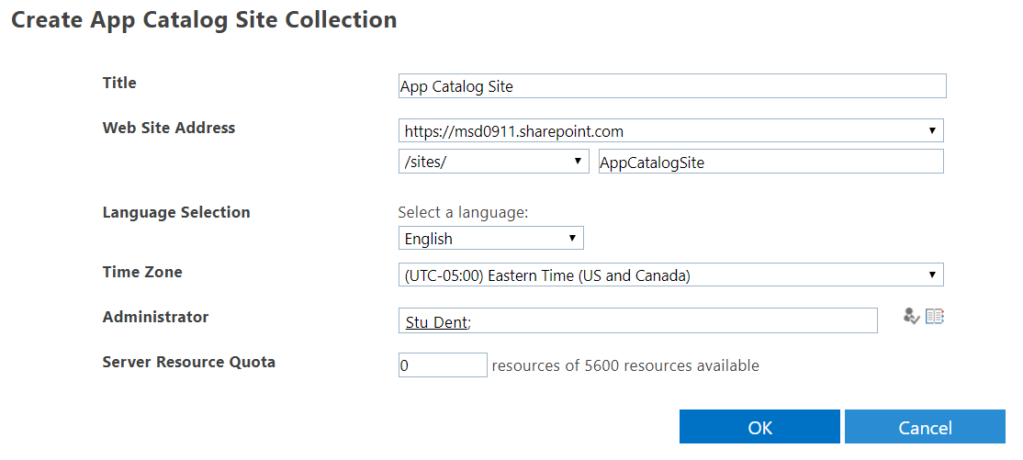
Creating the App Catalog Site Collection
You must create the App Catalog site collection
You can create it by hand in SharePoint admin center
You can create it with PowerShell script if required

Slide 5
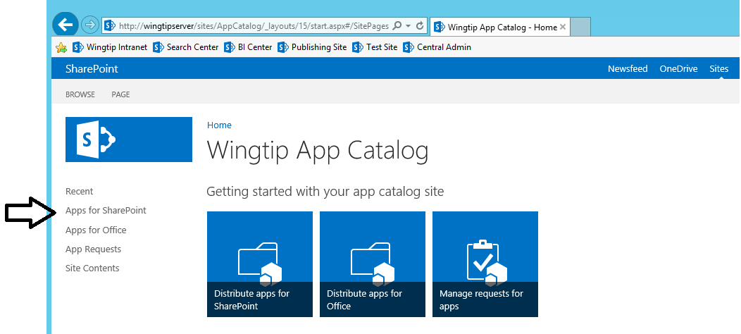
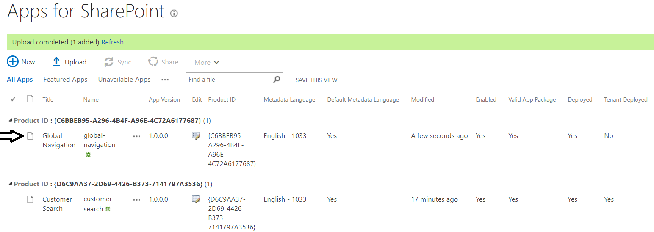
Apps for SharePoint Document Library
Apps for SharePoint is special document library
It's the place where you publish SPFx solutions
You upload solution package and enter the related metadata

Slide 6
Creating an App Catalog Site

Slide 7
Agenda
Creating the App Catalog Site in SharePoint Online
Packaging SPFX Solutions for Distribution
Publishing and Updating SPFX Solutions
Deploying Webpart Assets in Azure Storage

Slide 8
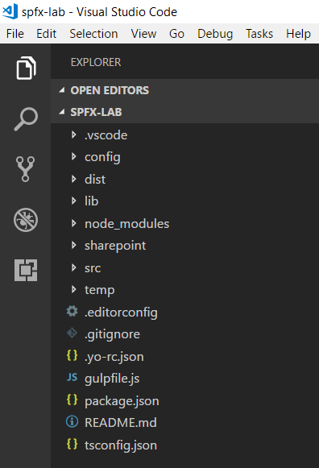
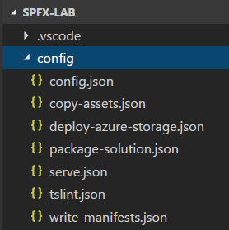
SPFx Project Configuration Files

Slide 9
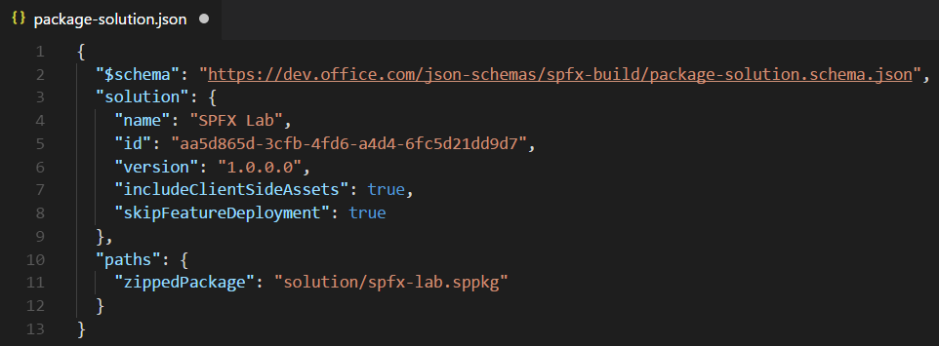
package-solution.json
package-solution.json
Contains top-level project properties (id, name, version)
includeClientSideAssets
skipFeatureDeployment
zippedPackage

Slide 10
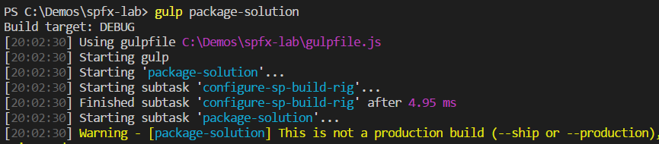
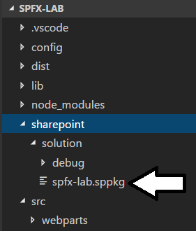
Building a SPFx Solution
Done by executing gulp package-solution
Can be done with or without --ship parameter
Generates zip archive with .sppkg extension

Slide 11
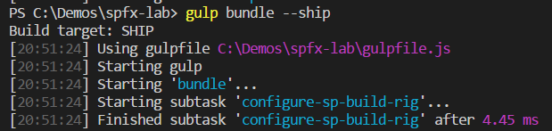
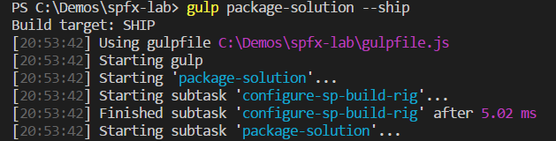
Packaging a SPFx Solution for Distribution
gulp bundle --ship
Uses dynamic URL for assets based on tenant CDN settings
gulp package-solution --ship
Uses dynamic URL for assets based on tenant CDN settings

Slide 12
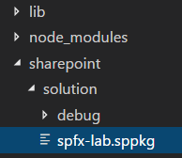
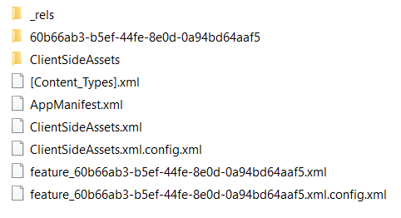
Inside a SPFx Solution Package
Your .js code is included in ClientSideAssets

Slide 13
Agenda
Creating the App Catalog Site in SharePoint Online
Packaging SPFX Solutions for Distribution
Publishing and Updating SPFX Solutions
Deploying Webpart Assets in Azure Storage

Slide 14
Deploying Solution to Office 365 Tenancy

Slide 15
includeClientSideAssets = True
If Office 365 CDN is enabled…
it will be used automatically with default settings.
If Office 365 CDN is not enabled…
assets will be served from app catalog site collection.

Slide 16
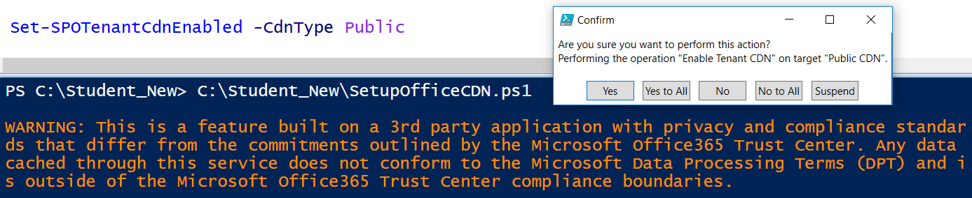
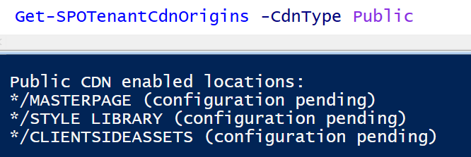
Enabling the Office 365 CDN
Office 365 provides CDN for SPFx solution deployment
Office 365 CDN must be enabled using PowerShell
Enabling CDN creates */CLIENTSIDEASSETS origin
CDN supports these file type extensions CSS, EOT, GIF, ICO, JPEG, JPG, JS, MAP, PNG, SVG, TTF, WOFF

Slide 17
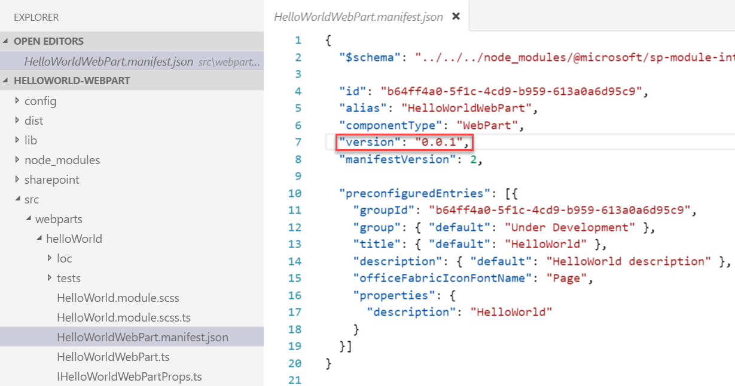
Update Webparts and Increment Version
Update the code or configuration for your web part
Increment the version in the <web part name>.manifest.json file
This sets the version for the web part
Multiple web parts in the same solution may be versioned independently

Slide 18
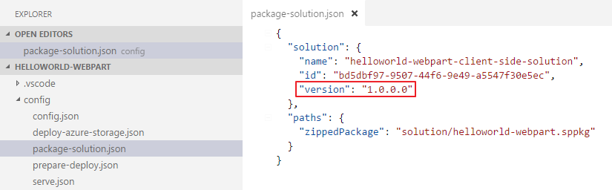
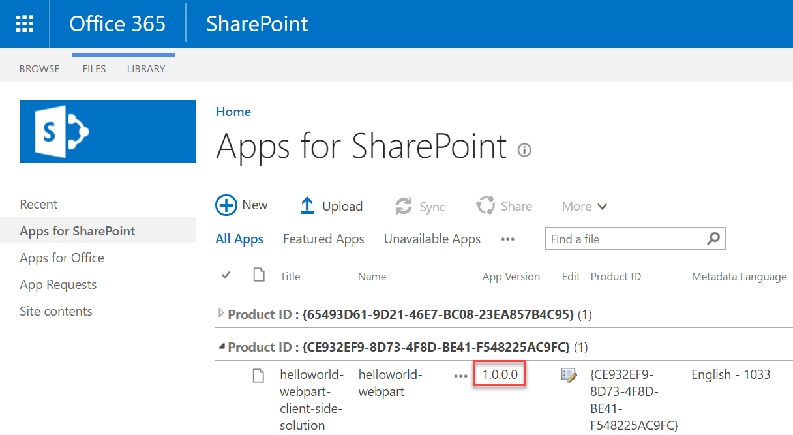
Update Version in package-solution.json
This sets the version for the .sppkg Add-in
This version is displayed in the app catalog

Slide 19
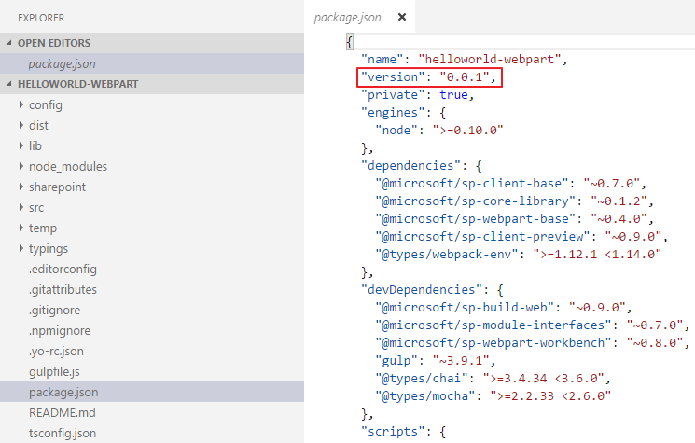
Update the version in the package.json file
Change the version every time the package changes
Notes:
The most important things in your package.json are the name and version fields. Those are actually required, and your package won't install without them. The name and version together form an identifier that is assumed to be completely unique. Changes to the package should come along with changes to the version.
Version must be parseable by node-semver, which is bundled with npm as a dependency. (npm install semver to use it yourself.)
More on version numbers and ranges at semver.

Slide 20
Agenda
Creating the App Catalog Site in SharePoint Online
Packaging SPFX Solutions for Distribution
Publishing and Updating SPFX Solutions
Deploying Webpart Assets in Azure Storage

Slide 21
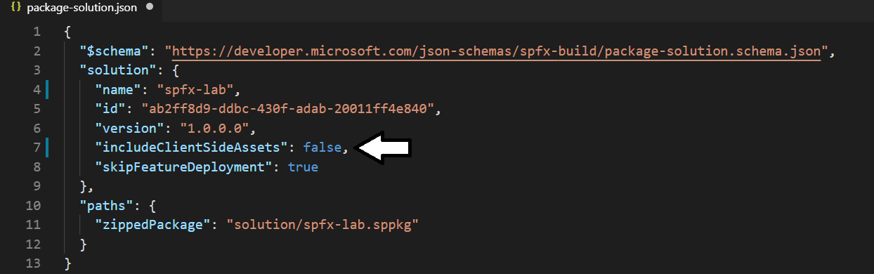
Deploying Client-side Assets to a CDN
What happens when includeClientSideAssets is false?
You must deploy the web part assets to a CDN location
You must update the cdnBasePath in the write-manifests.json file

Slide 22
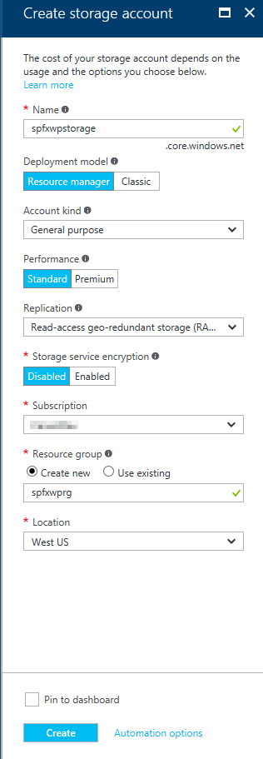
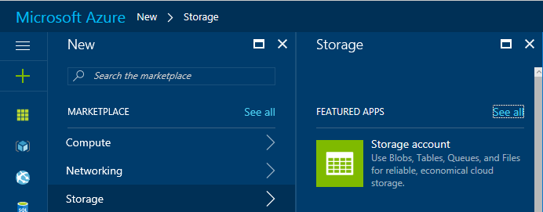
Create Azure Storage Account
Go to the Azure Management Portal
Create a new Storage Account

Slide 23
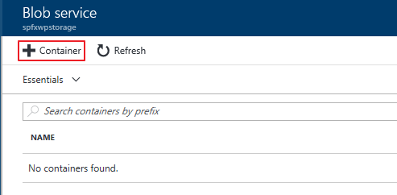
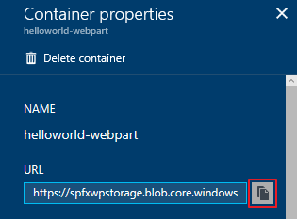
Create Blob Container in Storage Account
Create a Blob Container and copy the URL

Slide 24
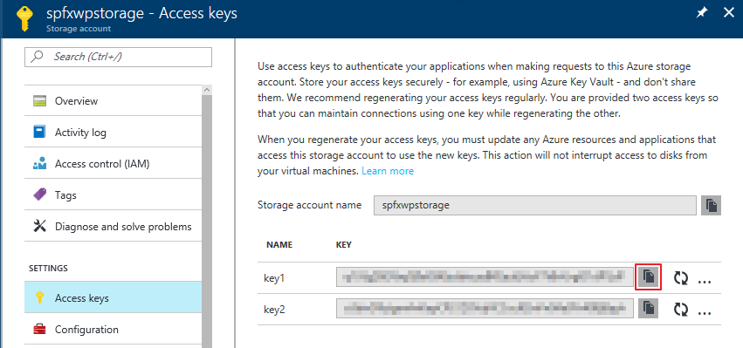
Obtain Storage Account Access Key
The Storage Account Access Key is used to automate deployments to the Azure Storage CDN, copy one of the keys

Slide 25
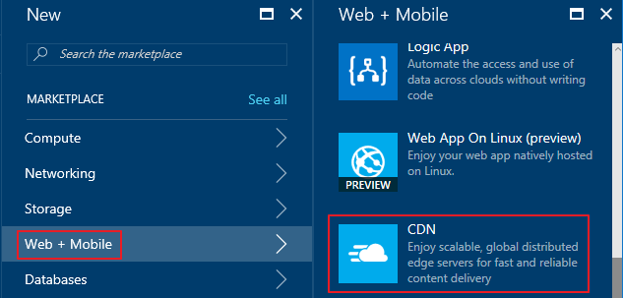
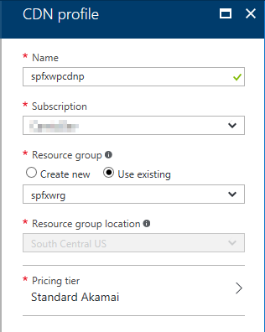
Create CDN Profile
In the Azure Management Portal, create a new CDN Profile

Slide 26
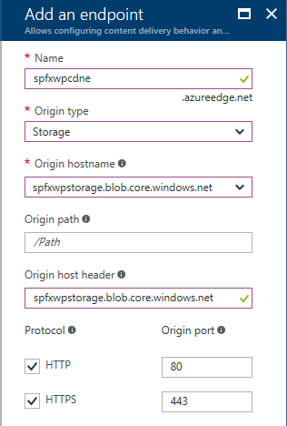
Create CDN Endpoint
In the CDN Profile, create a new CDN endpoint

Slide 27
Configure Webpart to Deploy Assets to CDN
Update the account, container, and accessKey in the deploy-azure-storage.json file
account – Storage account name
container – Name of the container you wish to use for the web part
accessKey – Storage Account Access Key
{
"workingDir": "./temp/deploy/",
"account": "spfxwpstorage",
"container": "helloworld-webpart",
"accessKey": "hL2503 … "
}

Slide 28
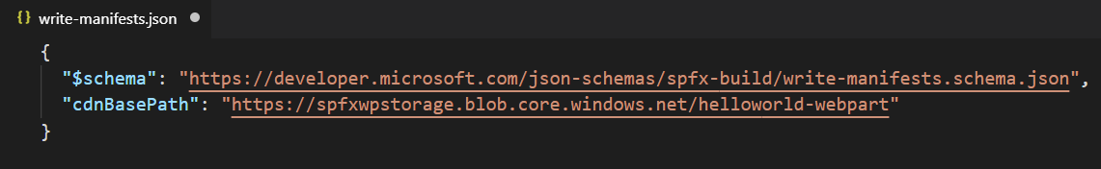
Configure the web part to use the CDN
Create CDN base path
https://<Storage Account Name>.blob.core.windows.net/<Container Name>
Update the cdnBasePath in the write-manifests.json file

Slide 29
Deploy web part assets to Azure
Use the deploy-azure-storage gulp task to deploy the assets to the Azure Storage Account
> gulp deploy-azure-storage
> gulp deploy-azure-storage
Build target: DEBUG
[11:56:24] Using gulpfile C:\SPFx\helloworld-webpart\gulpfile.js
[11:56:24] Starting gulp
[11:56:24] Starting 'deploy-azure-storage'...
[11:56:24] Starting subtask 'deploy-azure-storage'...
[11:56:24] [deploy-azure-storage] Uploading files '**/*.*' from directory './temp/deploy/' to Azure
[11:56:25] [deploy-azure-storage] Created container: helloworld-webpart
[11:56:25] [deploy-azure-storage] Uploading [3] files...
[11:56:26] [deploy-azure-storage] Uploaded file: helloworld-webpart-helloworldstrings_en-us_536e65149b0acf4d52c0043073b9fc59.js
[11:56:26] [deploy-azure-storage] Uploaded file: hello-world.bundle_b8a80975dedeb31de300b580fab61182.js
[11:56:26] [deploy-azure-storage] Uploaded file: dd331d09-a9cd-448d-a687-7e43060191e2.json
[11:56:26] [deploy-azure-storage] Upload complete!
[11:56:26] [deploy-azure-storage] Access your files at: https://spfxwpstorage.blob.core.windows.net/helloworld-webpart
[11:56:26] Finished subtask 'deploy-azure-storage' after 1.92 s
[11:56:26] Finished 'deploy-azure-storage' after 1.93 s
[11:56:26] ==================[ Finished ]==================
[11:56:27] Project helloworld-webpart version: 0.0.1
[11:56:27] Build tools version: 2.4.0
[11:56:27] Node version: v6.10.0
[11:56:27] Total duration: 5.94 s
deploy-azure-storage

Slide 30
Summary
Creating the App Catalog Site in SharePoint Online
Packaging SPFX Solutions for Distribution
Publishing and Updating SPFX Solutions
Deploying Webpart Assets in Azure Storage

